Slide 1


Sprint 8
Levi Graham
Riley Nichols

Slide 2
Goals for Sprint 8
Incorporation of Multiplexer with Main Circuit
Set up the AT Commands of Bluetooth Module
Incorporation of Bluetooth Module with Circuit
Finish Final Circuit
Build/Design 1st Generation of Haptic glove Housing.

Slide 3
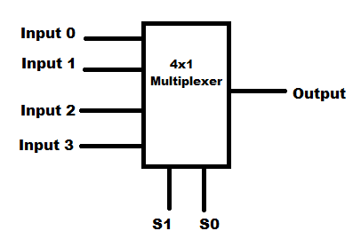
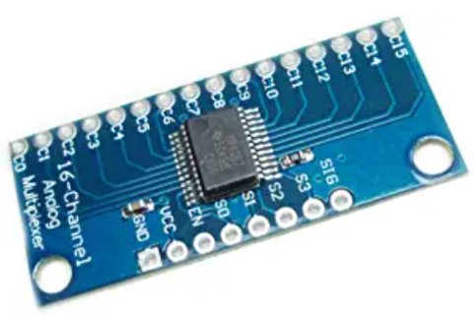
Multiplexer
Full success with the incorporation and implementation with the multiplexer to go from 2 inputs to 1 output read by the Arduino. This allows us to read 2 fingers at the same time meaning our system allows all 5 fingers and IMU sensor to function at the same rate.

Slide 4

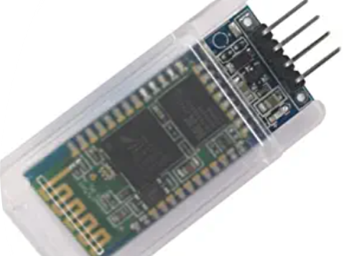
Bluetooth
Success
Access of AT Controls
Change BT Name & Baud Rate
Connected to Main circuit
Failures
Issues with connecting to computer to read serial Data wirelessly (has worked outside of complete circuit)

Slide 5
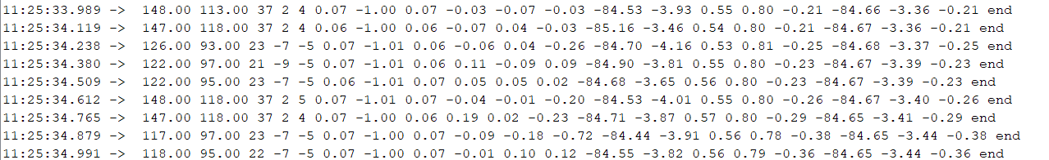
Circuit
Circuit is complete, capable of reading all sensor Inputs via Wired Communication
All data points are readable by the system at 100ms intervals
First two points are the multiplexer reads, values read changes on move, however values are not yet mapped correctly

Slide 6
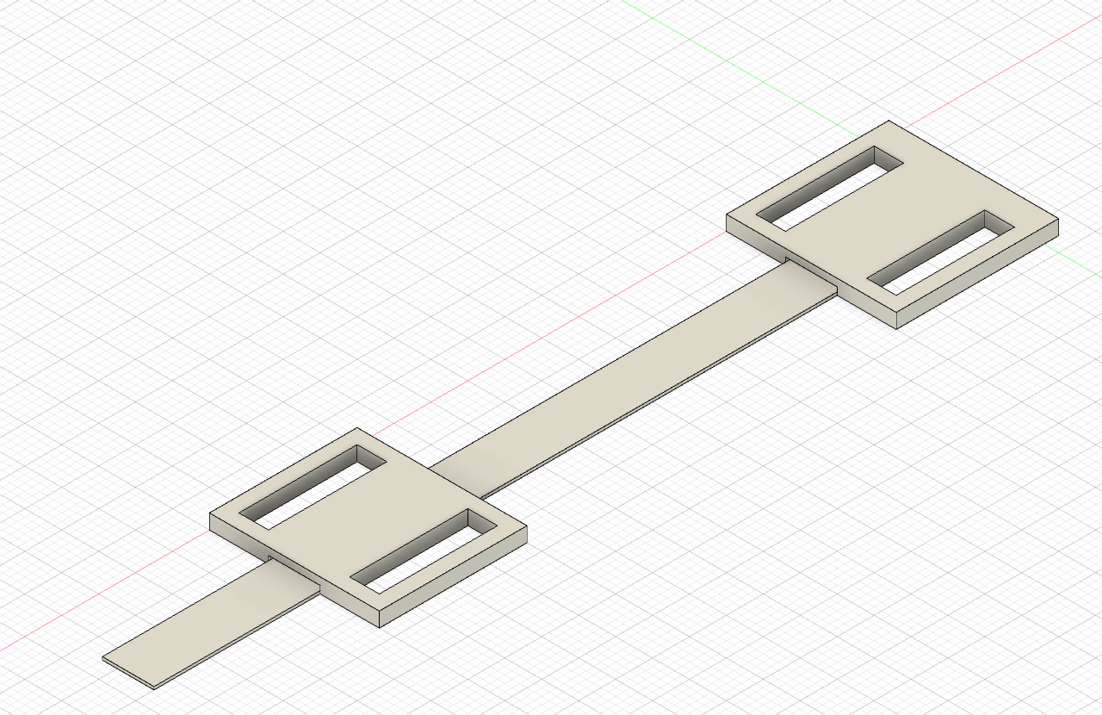
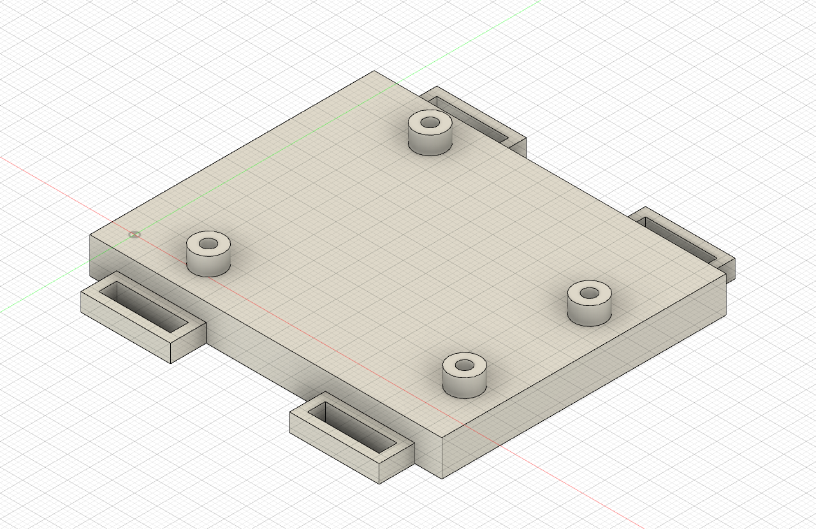
Housing
Started Designing Mounts for Arduino and Flex Sensors
Printed out the designs
Already found improvements to make

Slide 7
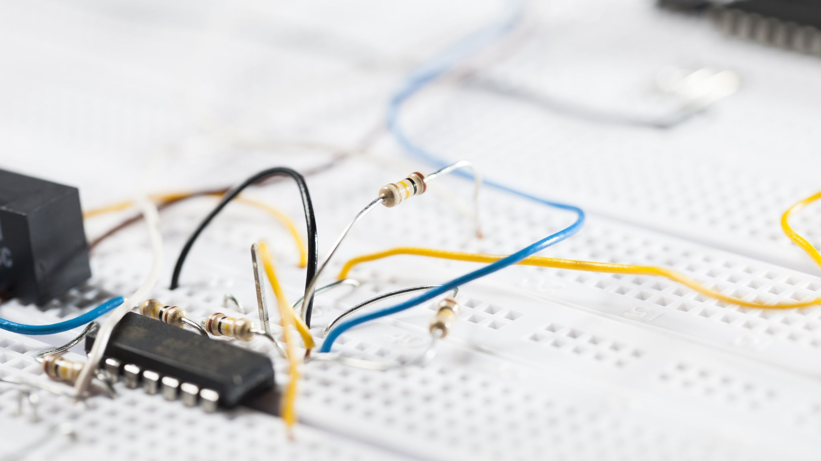
Goals for Sprint 9
Figure out issues with HC-06 wireless connection as COM port
Mapping and Soldering of PCB board
Soldering of Final Circuit
Mapping and Finalization of Code (Ongoing process)
Finishing of 1st Generation Hosing
Fitting of Soldered Circuit into Housing

Slide 8

Questions?

